Slide 1
صنعت تراشه‌های برنامه‌پذير

Slide 2

PLD Market: Major Players
Altera -> Intel
Xilinx -> AMD
Lattice
Actel → MicroSemi → Microchip
Atmel → Microchip
Cypress -> Infenion
Achronix

Slide 3
PLD Market: Major Players
Altera + Xilinx
~ 70% - 80%
Wikiinvest.com
finance.yahoo.com

Slide 4
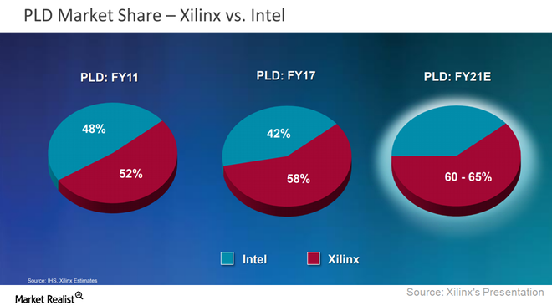
FPGA Market
https://www.fool.com/investing/2018/08/14/intel-is-gaining-against-its-biggest-rival-in-this.aspx

Slide 5
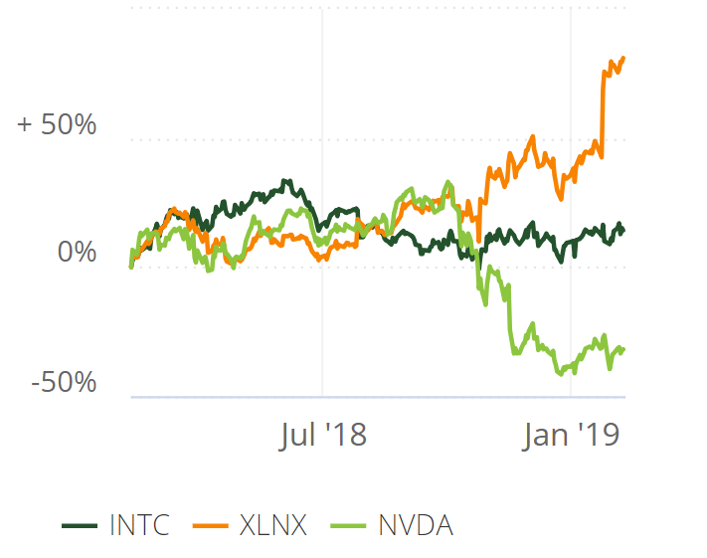
FPGA Market
Stock price: 2018-2019

Slide 6
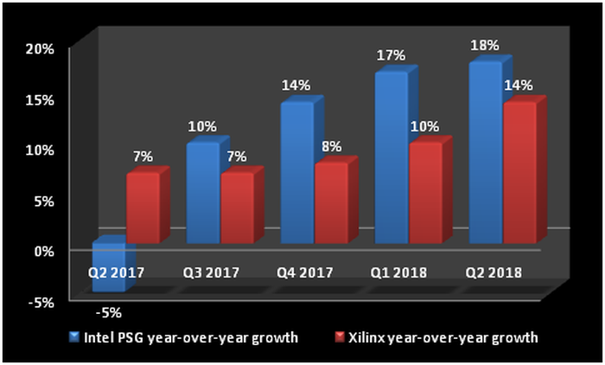
FPGA Market
https://www.fool.com/investing/2018/08/14/intel-is-gaining-against-its-biggest-rival-in-this.aspx
Notes:
PSG: programmable solutions group

Slide 7
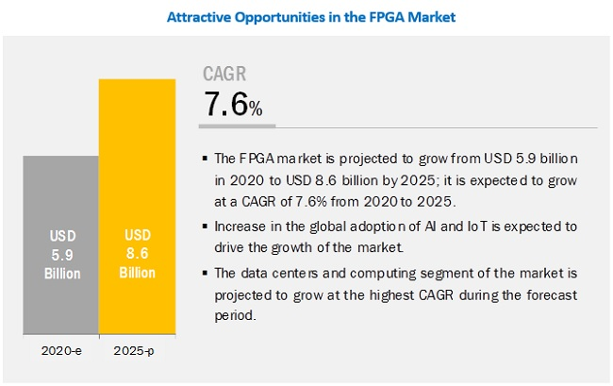
FPGA Market
FPGA market growth Forecast (2020-2025)
Growth rate: 7.6%
Driven by AI and IoT industry
16.4%
12.1 B
25.8 B
2024
2029
https://www.marketsandmarkets.com/Market-Reports/fpga-market-194123367.html?gclid=CjwKCAiAm-2BBhANEiwAe7eyFCwYl3i9aw8zLqdOxmKr0ugfup7BiLKqBlWJzldY5ILN8Z6_PE0yFhoCxUQQAvD_BwE
https://www.marketsandmarkets.com/ResearchInsight/fpga-market.asp

Slide 8
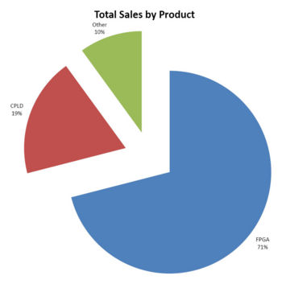
Altera PLD Products
[wikinvest.com], 2008
(2013: FPGA 71%)
Other
10%
CPLD
19%
FPGA
71%
http://www.wikinvest.com/images/thumb/1/1f/ALTR_salesbyproduct.jpg/350px-ALTR_salesbyproduct.jpg
http://www.wikinvest.com/stock/Altera

Slide 9
PLD Applications

Slide 10
Digital Systems
PLD today applications:
Data centers (Microsoft, Baidu):
First used multi-core systems
Then used GPU
Now using FPGA
More power-efficient than GPU
Can be reprogrammed for different tasks

Slide 11
Digital Systems
PLD today applications:
IoT (Internet of Things):
Connection of 80 B things by 2030
Needs platforms with high speed and low power
Inter-operability between systems

Slide 12
Digital Systems
PLD today applications:
AI (Artificial Intelligence) and machine learning:
Uses data to make devices intelligent by previous experience
Medical devices
Autonomous vehicles
Very hot topic: Hardware implementation of neural networks/deep networks

Slide 13
Digital Systems
PLD today applications:
….
Refer to AMD.com, Intel.com, …

Slide 14
Digital Systems
Digital systems implementation:
ASIC (Application-Specific Integrated Circuits)
Efficient for one application
→ Not suitable for another task
PLD (Programmable Logic Devices)
→ Programmable for different applications
Much more efficient than CPU/GPU (speed, power)

Slide 15
Speedups
Reported speedups:
Up to x28500
Reported speedups (till 2010):
Up to x28500

Slide 16
Speedups
SR: Super-Resolution:
Construction of high-resolution images from several low-resolution observations
Speedup: up to 4 orders of magnitude
[Georgis16]

Slide 17
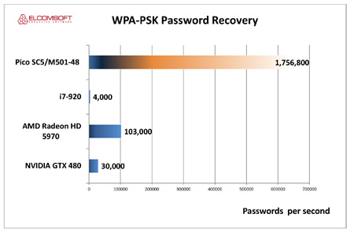
Speedups
Password guess:
Pico-FPGA board:
Xilinx Virtex-6 FPGA
i7-920:
Intel CPU
AMD Radeon:
AMD GPU
NVIDIA GTX 480
GPU
[ExtremeTech12]

Slide 18
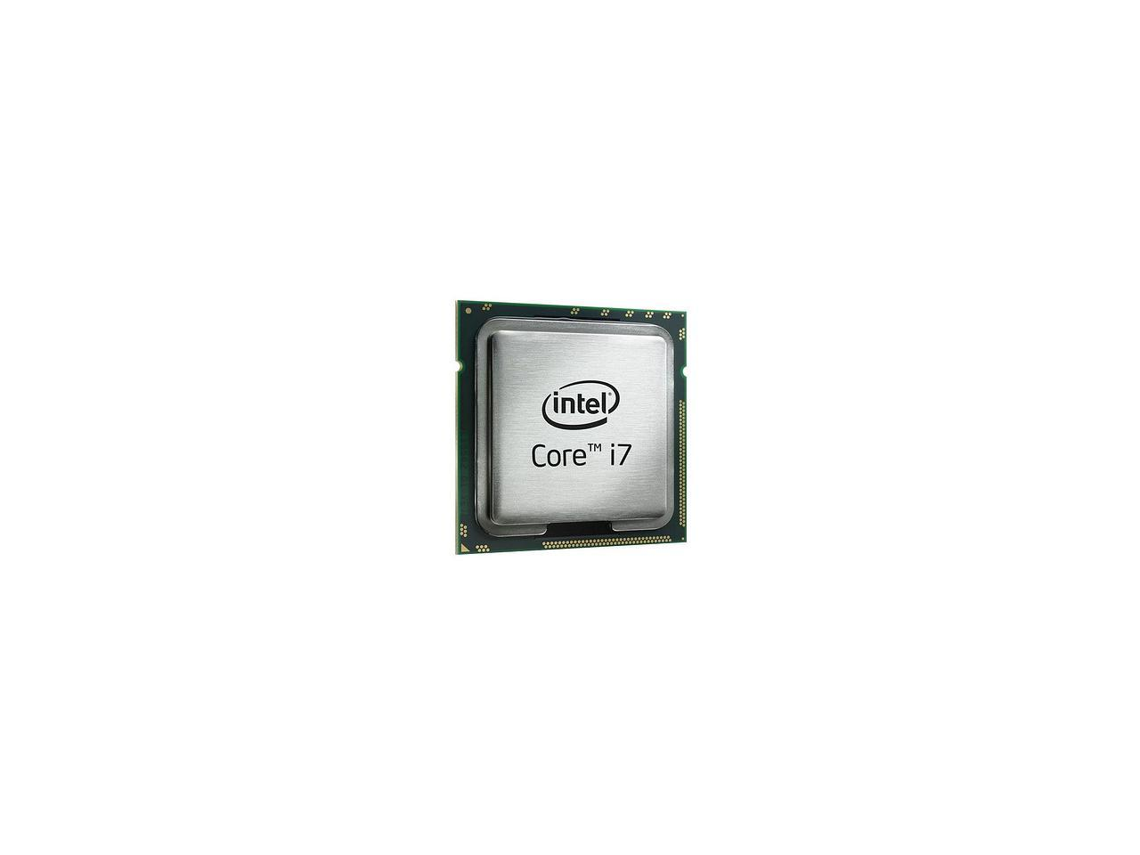
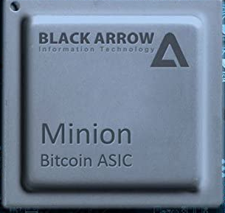
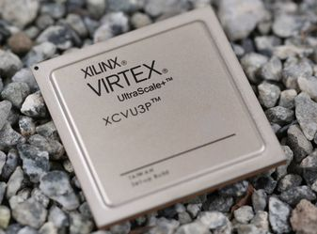
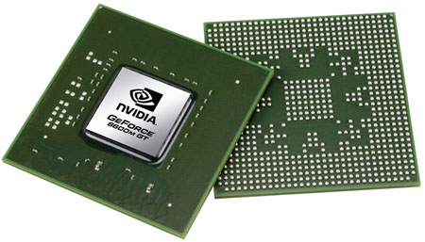
Speedups
Cryptocurrency mining

Slide 19
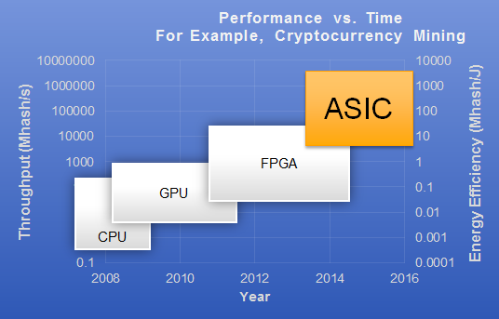
Speedups
Cryptocurrency mining:
Throuput and energy efficiency
[eSilicon16]

Slide 20
High-Performance Computing (HPC)
TOP500/Green500
Ranking of the 500 fastest and energy-efficient supercomputers since 1986/2007
Green500: Power-performance

Slide 21
HPC
HA-PACS:
University of Tsukuba
8th generation: adopted GPUs as computational nodes
GPUs could not share the data efficiently
Uses Stratix FPGA
164th place at the TOP500, 3rd place at the Green500

Slide 22
FPGA as a Network Chip
2020 Versal ACAP GTM (112Gb/s x 140)

Slide 23
FPGA as a Network Chip
Network companies with network products with FPGA:
Exablaze
Arista
Cisco
Mellanox
Simplex

Slide 24
Big Data: Web Search
Web search engines:
Scan huge databases to find the Web pages containing keyword(s)
Web pages are scored and sorted in terms of their relevance with the keyword.
Past:
Built on PC-based server clusters
Present:
Large-scale data centers facing power wall
→ FPGA
Microsoft Bing search engine uses Stratix and Arria 10 FPGAs
FPGAs in Microsoft's Intelligent Cloud Computing

Slide 25
Deep Learning
Microsoft Azure Project:
Accelerated Machine Learning with Project Brainwave
Uses Intel FPGA
Video: Azure Accelerated Machine Learning with Project Brainwave

Slide 26
Spiking Neural Neworks
[Isik23]

Slide 27
Homework
تحقیق درباره یک کاربرد FPGAها در صنعت:
نکات مهم:
حداقل 3 و حداکثر 4 صفحه
گزارش ها به زبان فارسی
اجتناب از ترجمه نامفهوم
انتخاب موضوع: حداکثر تا آخر وقت شنبه (10 مهر) در سامانه courses

Slide 28
Homework
Look for FPGA applications in Xilinx.com and Intel.com:
Xilinx → Applications:
Data Center
Video and Image Processing
Computational Storage
Database and Data Analytics
Financial Technology
High Performance Computing
Network Acceleration

Slide 29
Homework
Xilinx → Applications (continued)
Communications
5G Wireless
Wired Communications
Wireless Communications

Slide 30
Homework
Xilinx → Applications (continued)
Industry Solutions
Aerospace & Defense
Automotive
Broadcast & Pro A/V
Consumer Electronics
Emulation & Prototyping
Industrial
Medical
Test and Measurement

Slide 31
Homework
Xilinx → Applications (continued)
AI Inference Acceleration
Why Xilinx AI
Xilinx AI Solutions
Get Started with Xilinx AI

Slide 32
Homework
Intel: Industry Applications
Automotive
Broadcast
Computer & Storage
Consumer
Embedded Vision
Industrial
Medical
Military/Aerospace/Government
Test & Measurement
Wireless
Wireline

Slide 33
Homework
Intel: Industry Applications
5G Connectivity
Artificial Intelligence
Data Center
Intelligent Vision and Video
Internet of Things
Security

Slide 34
References
[ExtermeTech12] Tim Verry, “Are FPGAs the future of password cracking and supercomputing?” ExtremeTech, 2012.
[ExtermeTech16] Joel Hruska, “Intel launches Stratix 10: Altera FPGA combined with ARM CPU, 14nm manufacturing,” ExtremeTech, 2016.
[eSilicon16] neuASIC 7nm Platform for Machine Learning ASIC Design, eSilicon, 2016.
[Georgis16] Georgis, Georgios, George Lentaris, and Dionysios Reisis. "Acceleration techniques and evaluation on multi-core CPU, GPU and FPGA for image processing and super-resolution." Journal of Real-Time Image Processing (2016): 1-28.
[Peckham13] Clarence Peckham, “GPGPUs Stake Out Territory beside FPGAs for Military Signal Processing,” COTS Journal, April 2013.
Microsoft Co. (2019, April 8, Project Catapult, [Online]. Available: https://www.microsoft.com/en-us/research/project/project-catapult/#!videos

Slide 35
References
Microsoft Co. (2019, April 8, Project Catapult, [Online]. Available: https://www.microsoft.com/en-us/research/project/project-catapult/#!videos

